Slide 1
Websites!
with Grady

Slide 2
Let’s review...
The three languages for web development:
HTML - the content
CSS - the appearance
Javascript - the actions

Slide 3
CSS
Stands for Cascading Style Sheets
The APPEARANCE of the stuff on your site
Colors, borders, backgrounds, you name it!
These characteristics are assigned to specific things in your HTML in numerous ways

Slide 4
CSS is all about properties!
color - change the color of your element
text-align - align your text to the left, right, or center
font-family - setting the font of your text
font-size - changing the size of your text
background-color - determines the color of the background of the element
border - creates a border around the element
height - sets the height of a certain element
width - sets the width of a certain element
…. and so many many more things!!!

Slide 5
CSS uses classes and id’s!
A CLASS is an attribute you can add to multiple HTML elements in order to add the same stylistic features to all of them
An ID is an attribute you can use to single out one element of your HTML

Slide 6
How to add an id
<!DOCTYPE html>
<html>
<h1>Hello world!</h1>
</html>

Slide 7
How to add an id
<!DOCTYPE html>
<html>
<h1 id = “colorful”>Hello world!</h1>
</html>

Slide 8
The <style> tag
This tag is used to tell the computer which part of your file is CSS
This is similar to how the <html> tag tells it where the HTML is

Slide 9
Inserting the <style> tag
<!DOCTYPE html>
<style>
// all of our CSS will go in here
</style>
<html>
<h1 id = “colorful”>Hello world!</h1>
</html>

Slide 10
Finally… Let’s use some CSS!
<!DOCTYPE html>
<style>
#colorful {
color: blue;
}
</style>
<html>
<h1 id = “colorful”>Hello world!</h1>
</html>

Slide 11
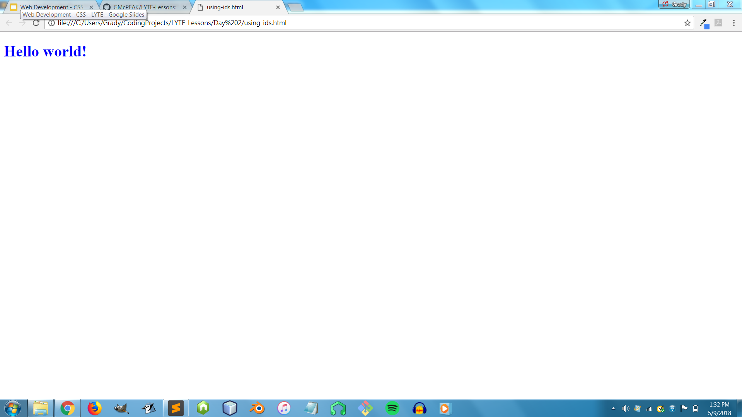
Finally… Let’s use some CSS!

Slide 12
How to add a class (It’s just like an id!)
<!DOCTYPE html>
<style>
</style>
<html>
<h1>Hello world!</h1>
<p>More text is going here!</p>
</html>

Slide 13
How to add a class (It’s just like an id!)
<!DOCTYPE html>
<style>
</style>
<html>
<h1 class=“colorful”>Hello world!</h1>
<p class=“colorful”>More text is going here!</p>
</html>

Slide 14
Using your class
<!DOCTYPE html>
<style>
.colorful {
color: blue;
}
</style>
<html>
<h1 class = “colorful”>Hello world!</h1>
<p class = “colorful”>More text is going here!</p>
</html>

Slide 15
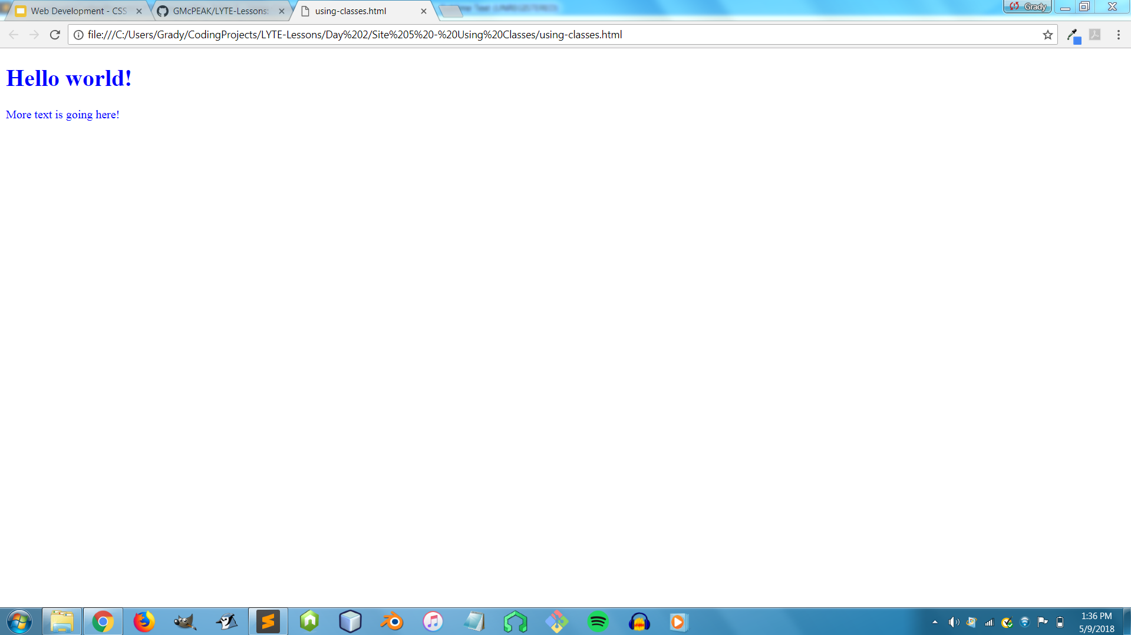
Using your class

Slide 16
Using both
<!DOCTYPE html>
<style>
.colorful {
color: blue;
}
#comic {
font-family: “Comic Sans MS”;
}
</style>
<html>
<h1 class = “colorful” id = “comic”>Hello world!</h1>
<p class = “colorful”>More text is going here!</p>
</html>

Slide 17

Using both

Slide 18

Resources
All webpages, slide shows, images, and bonus sites from these lessons can be found on a website called GitHub.
You can find all this stuff at https://github.com/GMcPEAK/LYTE-Lessons

